Slide 1
Docker for Web Developer
By: Hardik Raval

Slide 2
Docker Actually Isn’t Difficult to Use

Slide 3
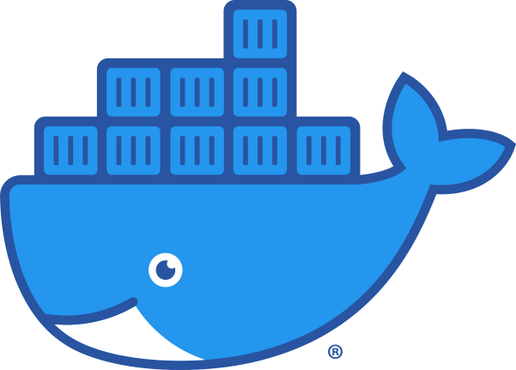
What is Docker?
Docker is a open source platform to run and build the application natively on Linux, MAC or windows.
Docker simplifies the process of building, shipping and running applications in different environments (dev, stage, prod).
Relies on “images” and “containers”

Slide 4

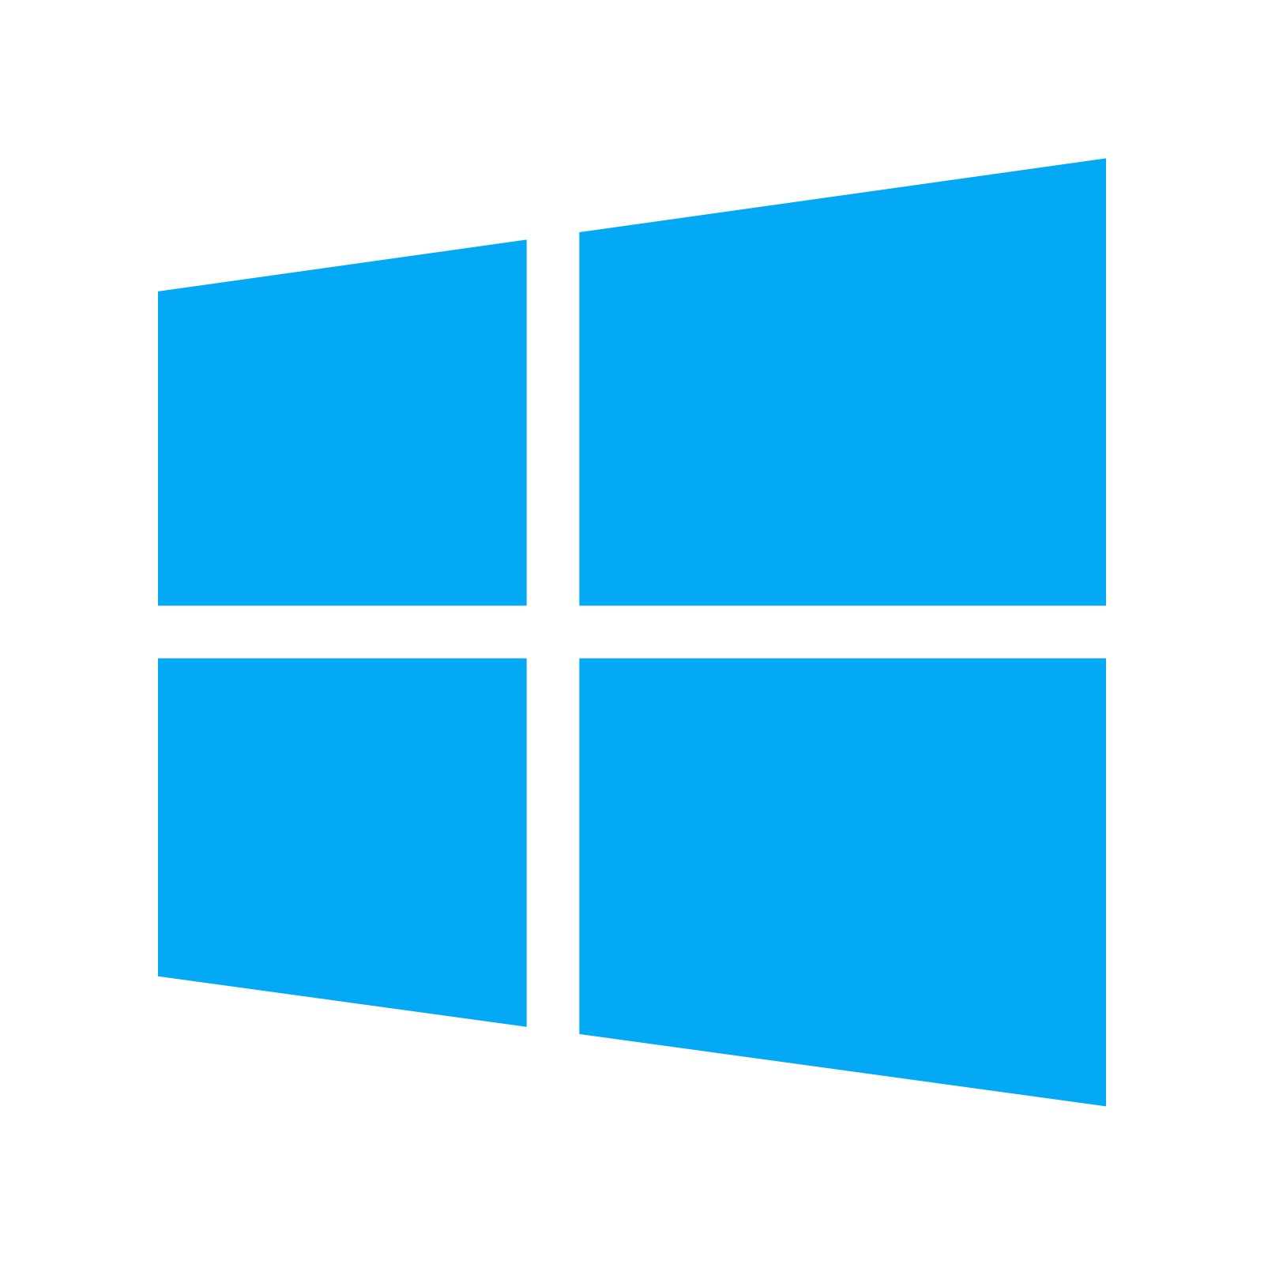
Where does Docker run?
Docker Client
Linux | Windows
Docker Engine (Daemon) | Docker Engine (Daemon)
Containers | Containers

Slide 5
Core Benefits
Set up development environments in minutes
Application code behaves same as others
Deploy easily in the production

Slide 6
Docker Terminology
Images - The blueprints of our application which form the basis of containers.
Containers - Created from Docker images and run the actual application.
Docker Hub - A registry of Docker images. We can host our own Docker registries and can use them for pulling images.
Docker Client - The command line tool that allows the user to interact with the daemon.
Docker Daemon/Engine - The daemon is the process that runs in the operating system which clients talk to.

Slide 7
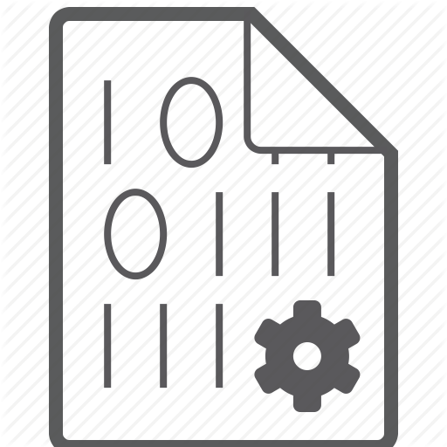
Docker Image
It’s more like a Software to run your application.
For example LAMP, XAMPP, WAMP, Visual Studio (not VSCODE)
It contains necessary files to run on operating systems like Windows or Linux and a specific framework like PHP, node.js etc.
Images are read only and we need to convert an image to container to run our application.

Slide 8

Docker Container (Read & Write)
Container is created from image and they are actually where the live application runs.
We can have different containers for different services.
For example, Database(MySQL), Caching Server (Redis). Language(PHP)

Slide 9
Role of Images & Containers
Docker Image
Docker Container
Example: Ubuntu, PHP
And application code
Created from image. Runs
Application code.

Slide 10
Make sure Docker is installed on your machine
Try executing following command in your terminal:
docker -v

Slide 11
Docker Hub Introduction

Slide 12
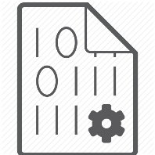
Pull Image
docker pull php
The pull command fetches the hello-world image from the Docker registry and saves it to our system.
We can use the docker images command to see a list of all images on your system
docker run php echo “Hello World”
docker run --help
See all available options for “docker run”

Slide 13
Pull Image & Running Container
Pull an image from registry
docker pull nginx
Run on specific port
docker run -p 8080:80 -d nginx
To serve static website using nginx
docker run -p 8080:80 -v /c/Users/dell/Desktop/static-website:/usr/share/nginx/html nginx

Slide 14
See running Containers
docker ps
The docker ps command shows you all containers that are currently running.
docker ps -a
So what we will see above is a list of all containers that we ran so far.

Slide 15
Stop Container
docker stop <container>

Slide 16
Removing containers & images
docker rm <id>
docker rm $(docker ps -a -q -f status=exited)
docker container prune
docker rmi <id/name>
docker rmi $(docker images -a -q)

Slide 17
Stay Tuned!

